Slide 1



04/04/2025
General Motors
McCombs School of Business
University of Texas at Austin
Capstone Team 8
Muhammad Ibrahim, Sarah Lee, Ammar Mustafa, Rohan Giri, Varsha Manju Jayakumar, John Hwang

Slide 2
Executive Summary
With growing demand for EV, GM aims to strategy place a 100 DC fast charger infrastructure
EV market in the US is growing at circa 10%, with GM market share as second largest at 16.5%
Tennessee is a prime market to deploy and test this framework, that can be conveniently scaled to other states
Our charger placement algorithm, fulfills 52.6% of the overall estimated state demand for 2028 by placing chargers in 74 zip locations
Insights show significant impact of demographic factors such as income, family structure, wfh and commute times on ev car sales
GM implementation can be done based on location prioritization provided through algorithms, and scalability through framework
Notes:
Key Challenges

Slide 3
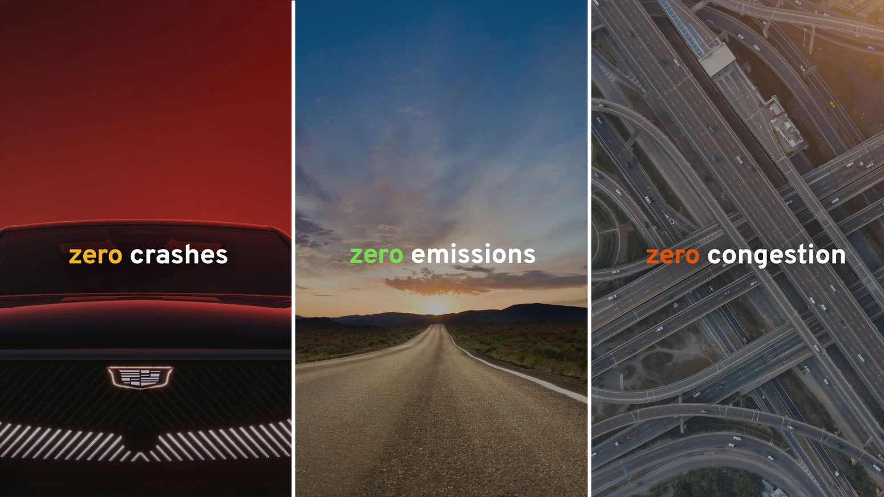
Problem Statement
Strategically identify where to place 100 new DC fast chargers within a target state to drive EV adoption, meet demand, find insights and support long-term growth in the EV market.
State of Choice: Tennessee
Home to GM’s largest EV facility in Spring Hills, TN
7.2M residents across 3 major cities
Above median (29.9%) EV adoption rate
$88M in federal EV infrastructure funding through the BEAD program
Business Opportunity
Drive GM EV sales by addressing both current and forecasted gaps in public charging infrastructure.
Support equitable EV adoption by expanding access across diverse regions
Advance GM’s zero-zero-zero vision

Slide 4
Exploratory Data Analysis

Slide 5
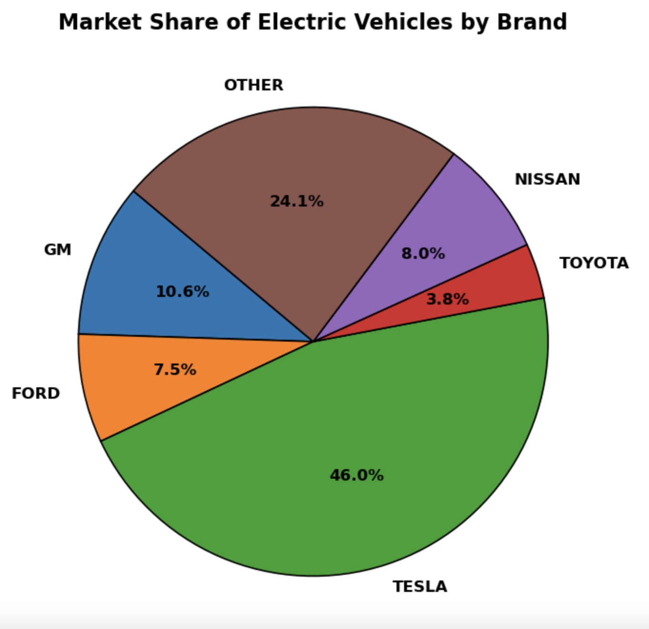
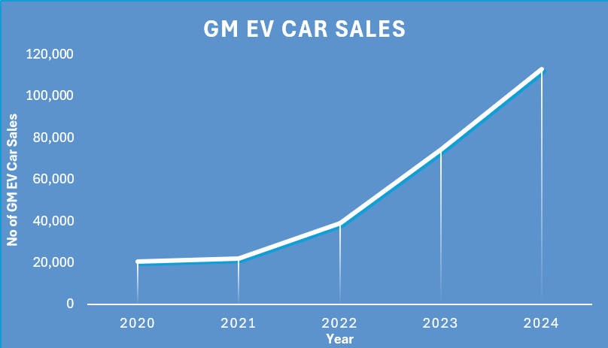
GM Market Share & EV Car Sales
Notes:
Label the table

Slide 6
Approach & Methodology
Notes:
Include supply and demand imbalance

Slide 7
Project Workflow - Part 1: Data
Data Sources
Feature Engineering - 1
Feature Engineering - 2
Demographics
Source: census.gov
EV Registrations forecast 2028
Data: ZCTA, Year, Features…, EV Sum
Extrapolation:
Linear on all features
Model:
Random forest
Best model chosen on Train(2020-2023) Test(2024)
Best model re-trained on (2020-2024) Test (2025-2028)
Charging Demand Gap Score
w1
Registrations
Source: GM
Profits from Charger Use Score
w2
EV Charging Network
Source: energy.gov
Traffic Score
w3
Market Averages
Source: Public reports
Normalize to same scale
Business Density Score
w4
Traffic Data
Source: Tennessee gov
Sparsity Control (Optional)
w5
Business Points
Source: Google Maps
Charging Capacity & Charging Demand
Charging Demand Gap
Composite Score
Notes:
Explain in detail
Make separate slides explaining some of these boxes
Clarify each input
Replace aadt with vmt?
Take out demographic within optimization (double counting with rf)

Slide 8
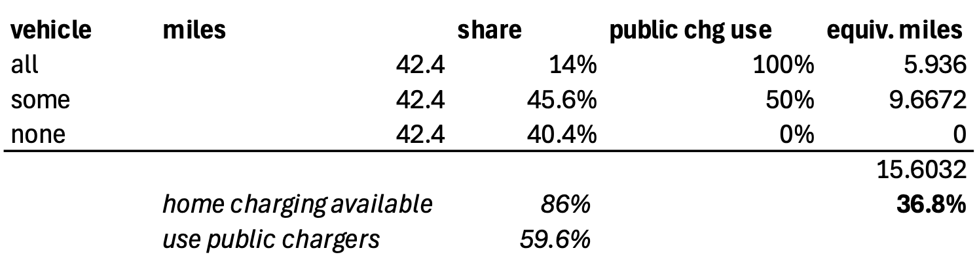
Metric Calculations
- Charging Demand Gap: Charging Demand - Charging Capacity
Charging Demand = EV_Cars_2028 * Avg_miles_driven_per_car * perc_charged_in_public Count_per_zipcode * 42.4 * 36.8%
Charging Capacity = ((DC_chrgr_cnt * Avg_range_per_hour) + (L2_chrgr_cnt * Avg_range_per_hour)) * hours_in_operation (DC_count_per_zipcode * 180) + (L2_count_per_zipcode * 25) * 14
- Profits from charger use: DC_capacity_per_charger * sell_price_per_mile - (DC_capacity_per_charger * cost_price_per_mile + rent_per_charger/day) DC_count_per_zipcode * 180 * $0.14 - (L2_count_per_zipcode * 25 * $0.04 + rent_per_zipcode_classification)
- Sparsity control (optional, kept at 0 weight for our solution):
(Feature1_std * Weight of Coeff 1) + (Feature2_std * Weight of Coeff 2) + …… + (FeatureN_std * Weight of Coeff N) // Features selected by running regression analysis on ev car sales with demographic factors, keeping only statistically significant ones
- Traffic Data (VMT; Vehicle Miles Travelled):
Annual sum of miles traveled by all vehicles within a zip code

Slide 9
Project Workflow - Part 2: Charger Placement
Data Sources
1. Greedy Algorithm
2. MIP Global Optimization
Validation Purposes
Charging Demand Gap Score
w1
Initial Charging Demand Gap
Gurobi Optimization
Decision Vars: Number of Chargers in each Zip Code
Objective Function: Maximise Score
Profits from Charger Use Score
w2
for each charger: highest score and demand unmet
Traffic Score
w3
Normalize to same scale
Business Density Score
w4
Place Charger
Sparsity Control (Optional)
w5
Chargers count - 1
Recalculate Charging Demand Gap
74% of chargers mapped like greedy approach
Composite Score
63-74 locations locations covered under sensitivity analysis
Notes:
Explain in detail
Make separate slides explaining some of these boxes
Clarify each input
Replace aadt with vmt?
Take out demographic within optimization (double counting with rf)

Slide 10
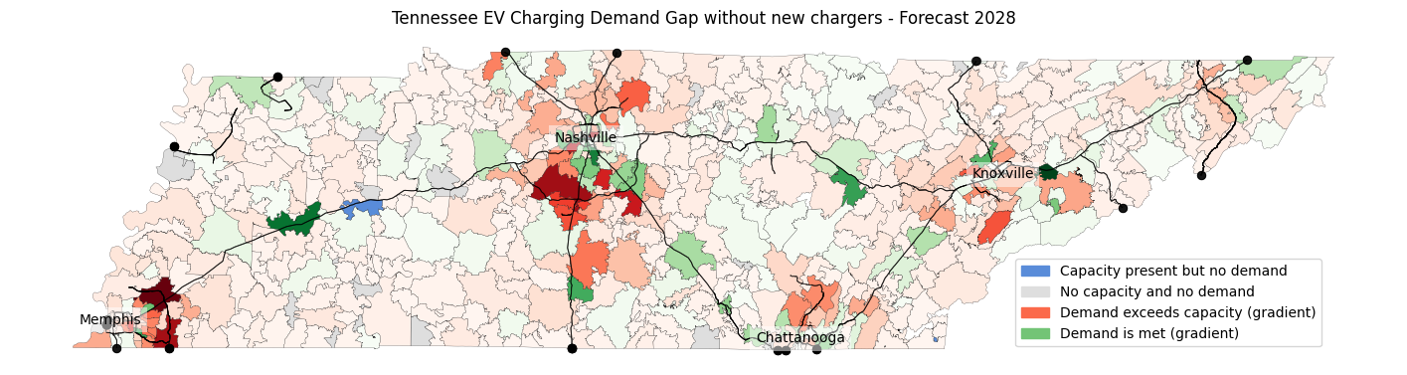
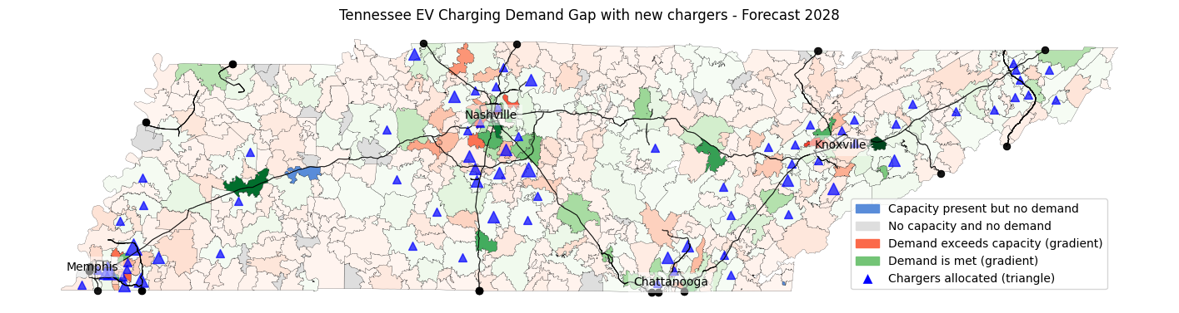

Slide 11
Insights on Drivers of EV Demand
Notes:
Include supply and demand imbalance

Slide 12
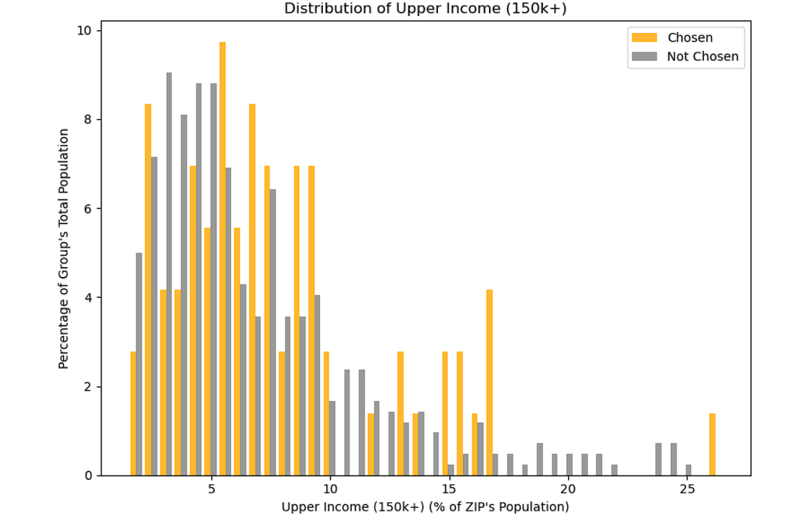
Demographics- Income
Both Chosen and Not Chosen ZIPs have a strong presence in the 2%–7% upper-income range, showing that chargers weren't exclusively placed in wealthy areas.
However, Chosen ZIPs extend further into the 10%–20%+ range, suggesting a broader income distribution and a slight skew toward higher-income areas compared to Not Chosen ZIPs.
Notes:
Change normalized freq to percentage

Slide 13
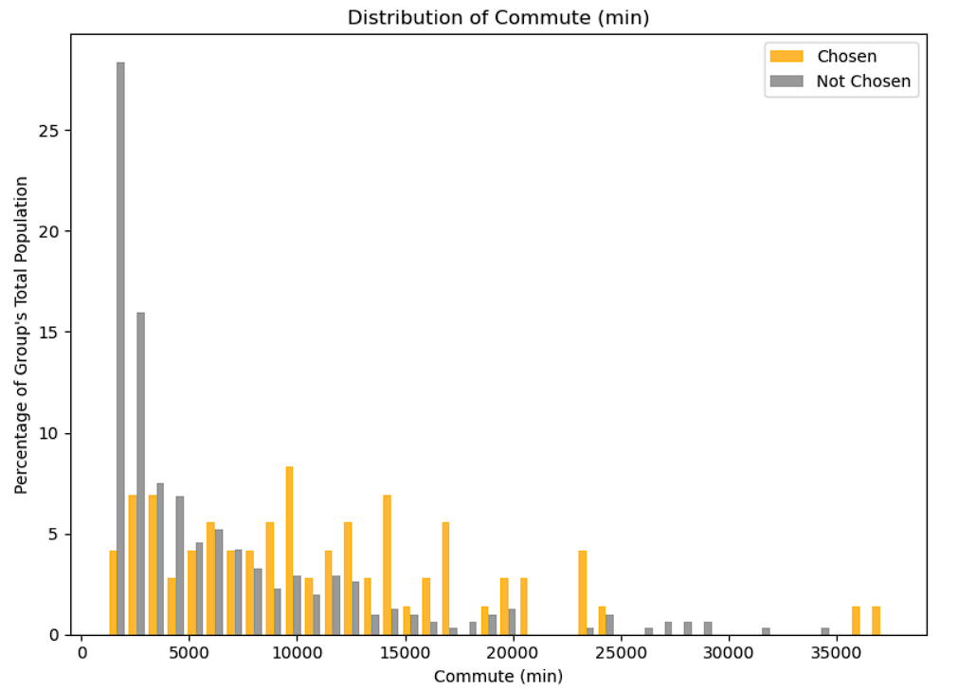
Demographics- Commute time
Not Chosen ZIPs are heavily concentrated in shorter commute times, especially under 5,000 minutes total (suggesting more localized travel or denser areas).
Chosen ZIPs are more evenly spread out across longer total commute minutes, indicating charger placements tended to occur in areas with higher overall travel burden or possibly larger commuter populations.

Slide 14
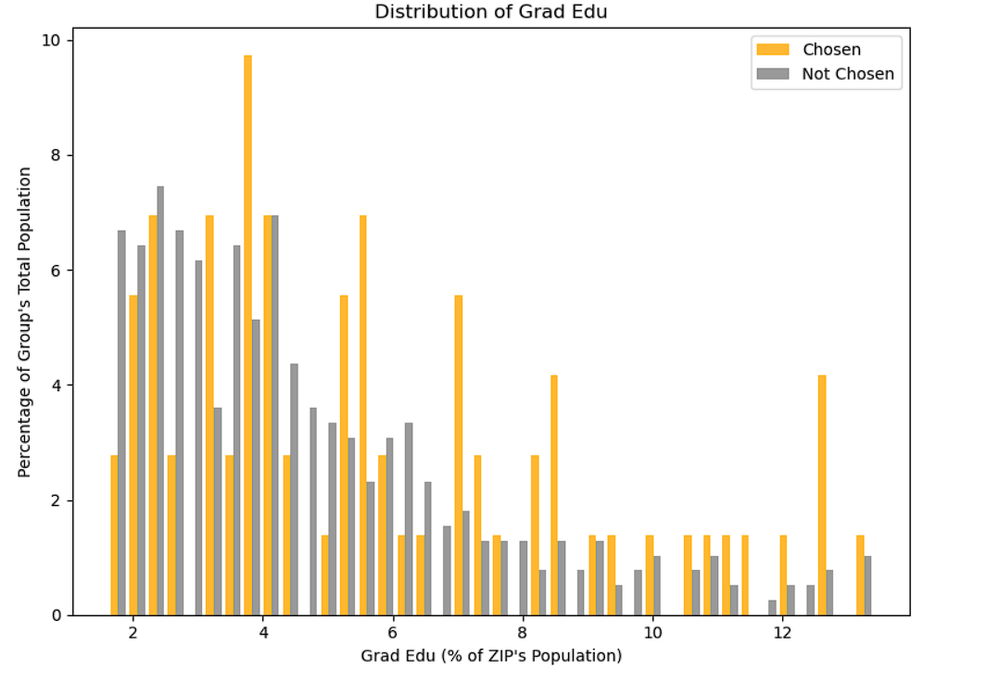
Demographics- Education Level
Not Chosen ZIPs have a stronger concentration in areas where only 2–5% of the population has graduate education, indicating lower education density.
Chosen ZIPs are more evenly spread and slightly skewed toward higher graduate education levels, suggesting that charger placement slightly favored more educated ZIPs.

Slide 15
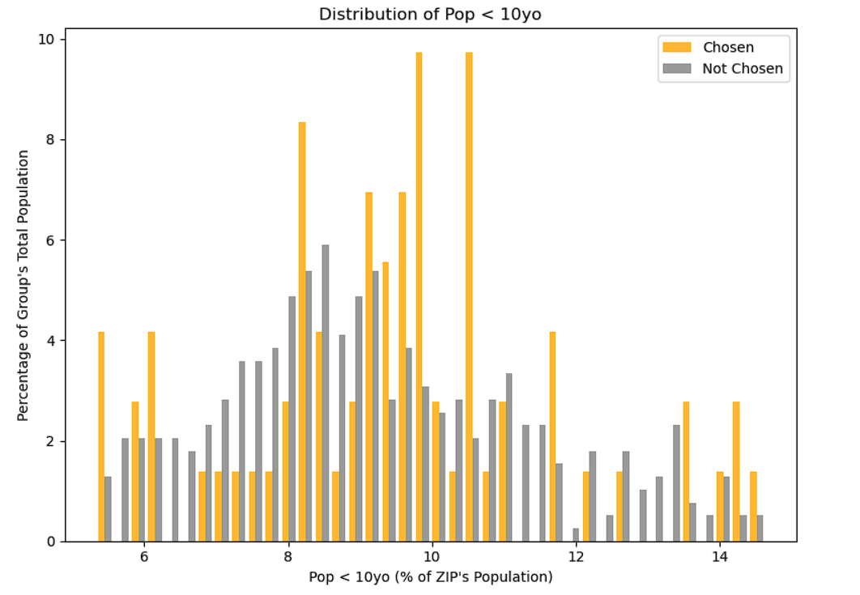
Demographics- Family
Not Chosen ZIPs are more concentrated around 8–9% of the population being under 10 years old, showing a slightly tighter and lower-centered distribution.
Chosen ZIPs are more spread out across the 7–14% range, indicating that EV chargers were placed in ZIPs with both average and relatively higher proportions of young children.
Notes:
Include total pop chart
Percent of pop under 10yrs
How is it different than total pop?

Slide 16
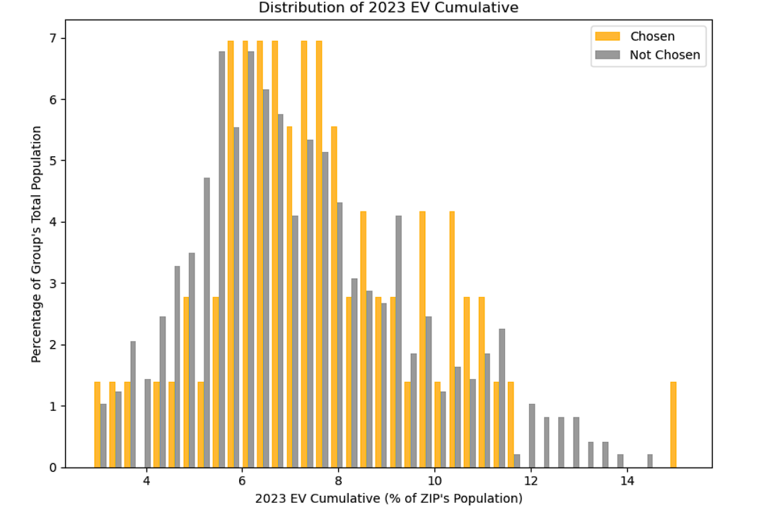
EV Registration
Most ZIP codes, regardless of whether they got chargers or not, have EV ownership rates between 6–9% of the ZIP’s population. That’s where both orange (chosen) and gray (not chosen) bars are concentrated.
However, ZIPs with chargers (orange) extend farther into higher EV adoption zones (10%–14%), suggesting charger placement was responsive to growing EV demand in those areas.
Notes:
Also include total vmt graph

Slide 17
Operational Execution & Change Management

Slide 18
Operational Execution & Pilot Planning
Integrated Multi-Source Data
Standardized ZIP-level data from GM, public infrastructure, demographics, traffic, business sources.
Iterative Model Development
Forecasted EV adoption using regression models.
Used greedy optimization to simulate charger allocations.
Incorporated demographic, rent, utilization data for prioritization.
Pilot Planning & Test Scenarios
Identified ~350 underserved ZIPs using demand-capacity and business/demographic scores.
Simulated initial charger placement (e.g., 100 chargers using greedy optimization).
Notes:
Why tennessee in the beginning
Reorganize the conclusion section

Slide 19
Change Management & Next Steps
Transition to Action
Defined KPIs: charging demand fulfillment, profits, traffic, business and demographics
Delivered final recommendations aligned to GM goals and budget.
Next Steps
Deployment Strategy: Begin with the top-tier ZIP codes identified by the model, focusing on areas with the largest charging demand gap and strongest profit potential.
Pilot → Scale: Launch initial chargers in high-priority zones, then scale using our repeatable, data-driven framework across other states or markets.
Ongoing Monitoring: Use internal dashboards to track charger usage, EV growth, and ROI

Slide 20
Thank you

